Slide 1

Santander Customer Transaction Prediction
Chris Blé, Mounir Ettaouti, Clovis Clotail

Slide 2
Summary
Objective and Dataset
Statistical testing & relevant features selection
ML Decision Tree Classifier
Base Model - Train Set (75% of dataset)
+ Gridsearch – Train Set (75% of dataset)
+ Gridsearch – Test Set (25% of dataset)
ML Gradient Boosting Classifier
Base Model - Train Test (75% of dataset)
+ Gridsearch (Train Set 75% of dataset)
+ Gridsearch (Test Set 25% of dataset)
Why choose our model ?
References
Data Processing
Modeling

Slide 3
I. Objective and Dataset
Objective: identify which customers will make a specific transaction in the future, irrespective of the amount of money transacted.

Slide 4
Data Processing

Slide 5
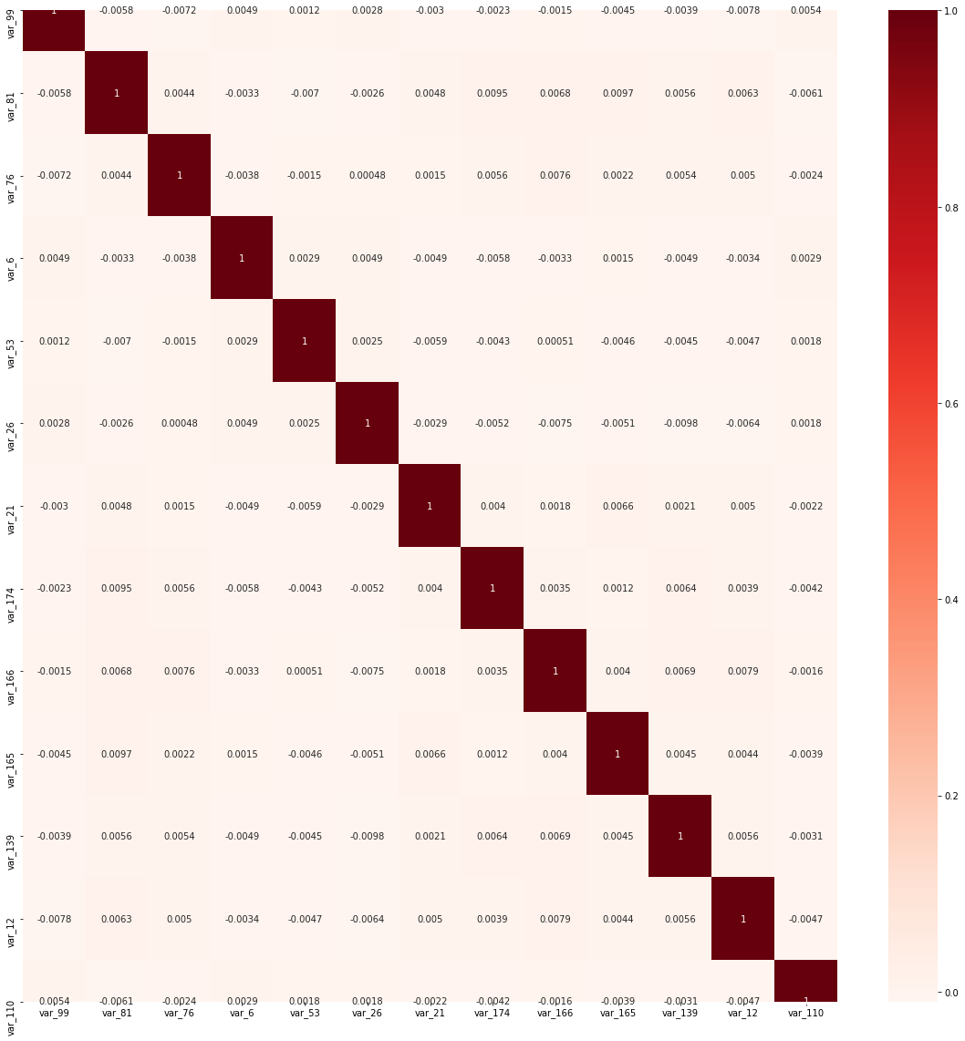
II. Statistical testing & relevant features selection
Correlation Matrix (13 relevant features)
Recursive features elimination using Gradient Boosting classifier, Logistic Regression and Decision Tree
Pearson correlation, Chi2 & ANOVA FValue
=> 45 relevant features with no autocorrelation
13 relevant features

Slide 6
Modeling

Slide 7
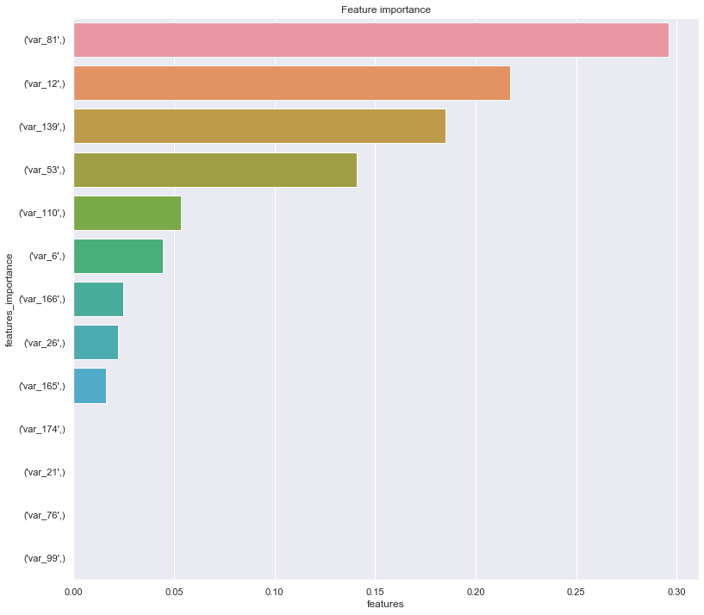
III. ML Decision Tree Classifier
Base Model - Train Set (75% of dataset)
Feature Importance
Confusion Matrix

Slide 8
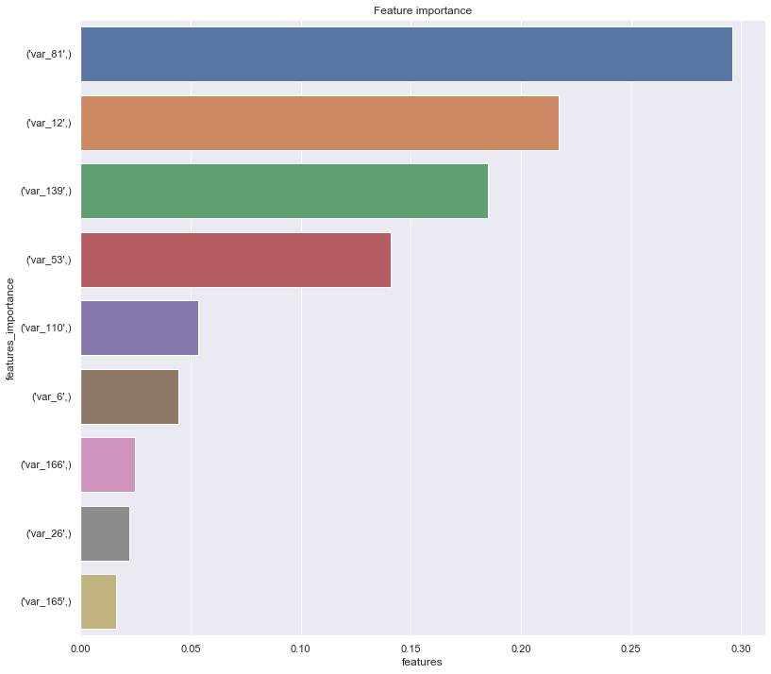
III. ML Decision Tree Classifier
+ Gridsearch – Train Set (75% of dataset)
Feature Importance
Confusion Matrix

Slide 9
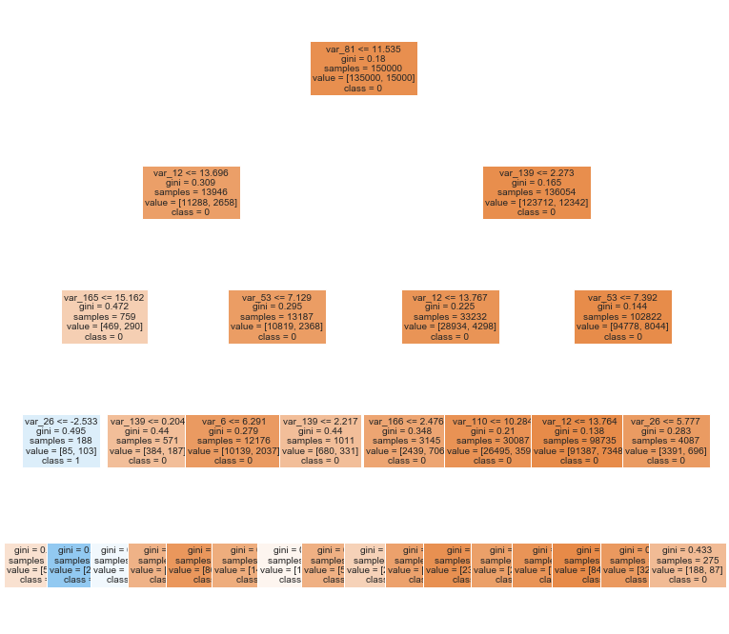
III. ML Decision Tree Classifier
+ Gridsearch – Train Set (75% of dataset)

Slide 10
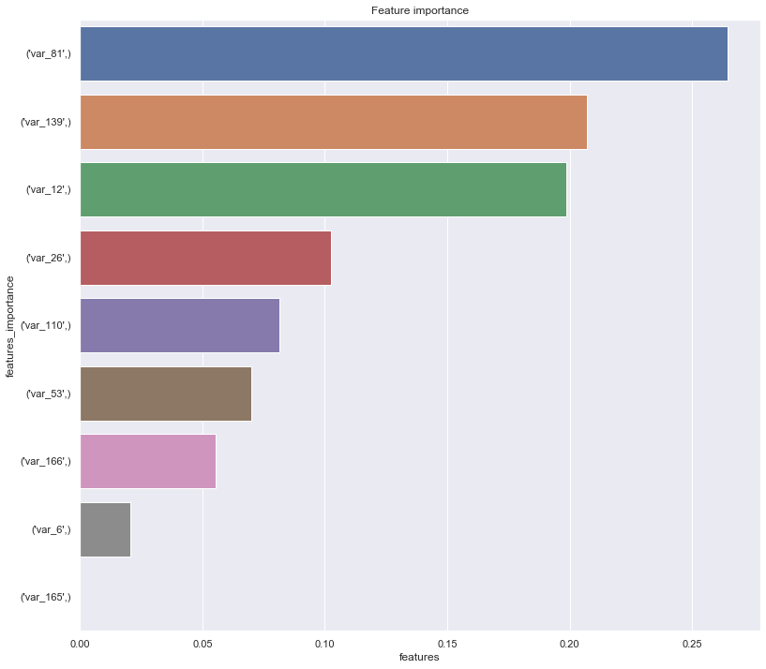
III. ML Decision Tree Classifier
+ Gridsearch – Test Set (25% of dataset)
Feature Importance
Confusion Matrix

Slide 11
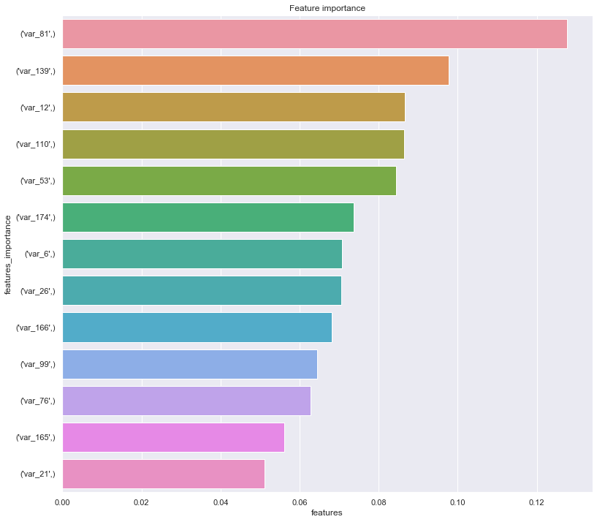
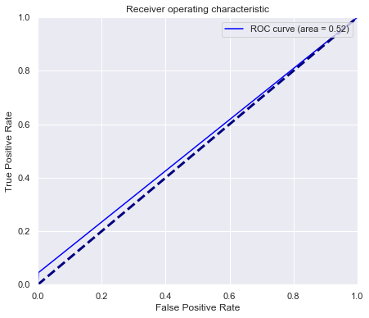
IV. ML Gradient Boosting Classifier
Base Model - Train Test (75% of dataset)
Feature Importance
Confusion Matrix
ROC Curve – area = 0,52

Slide 12
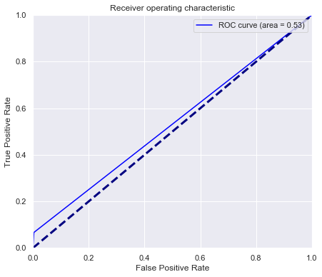
IV. ML Gradient Boosting Classifier
+ Gridsearch (Train Set 75% of dataset)
Confusion Matrix
ROC Curve – area = 0,53

Slide 13
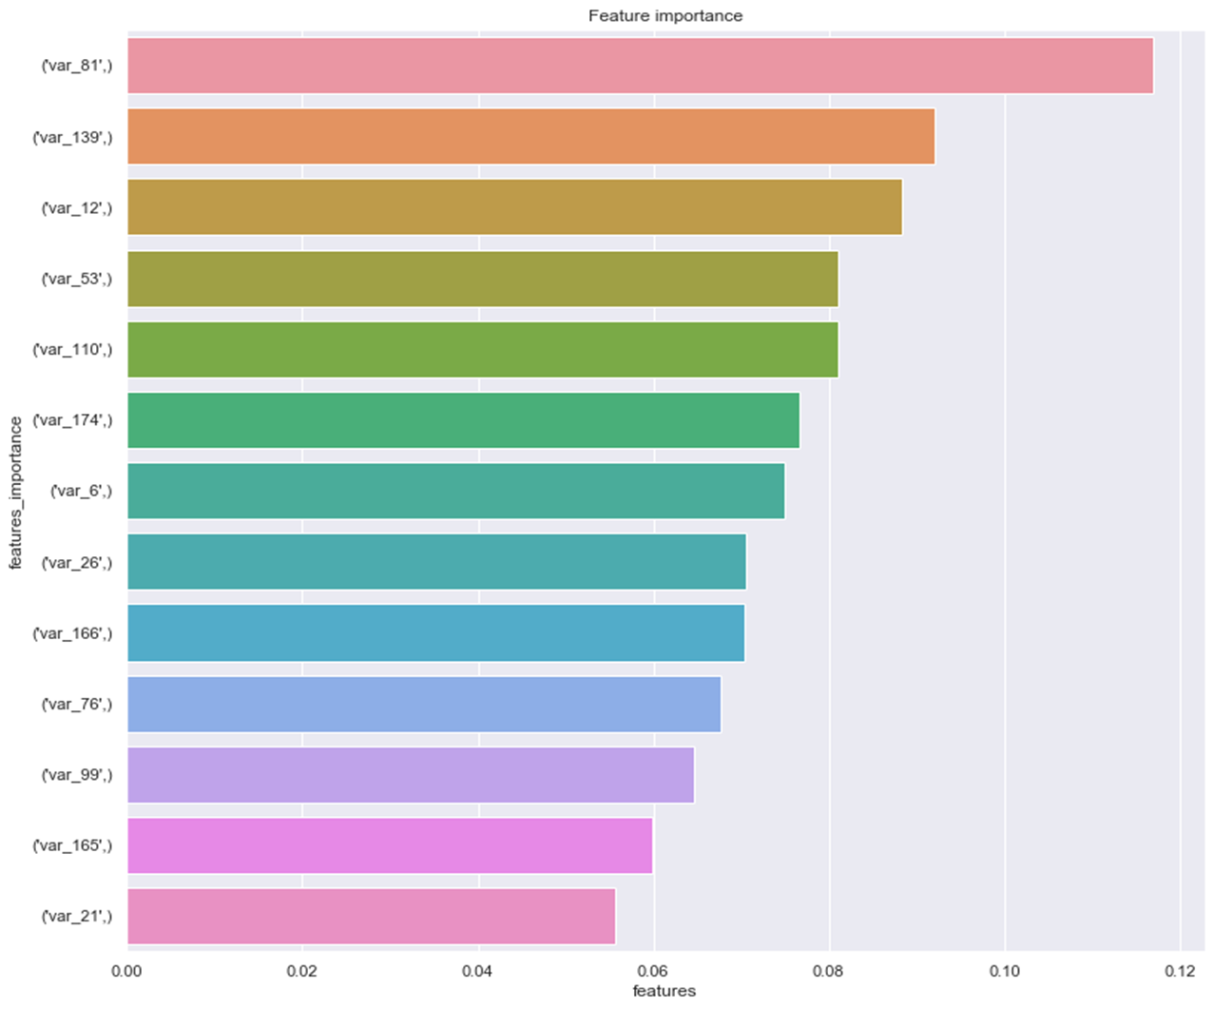

IV. ML Gradient Boosting Classifier
+ Gridsearch (Test Set 25% of dataset)
Feature Importance
Confusion Matrix
ROC Curve – area = 0,54

Slide 14






V. Why choose our model ?
What’s at stake for Banco Santander ?
Identify the most relevant features in transaction occurrence
Enable a more focused and informed analysis on customer behavior
What was achieved by our model ?
Accuracy of 0,9038 and ROC area of 0,54
Feature reduction: from 200 to 13 relevant features

Slide 15
VI. References
https://scikit-learn.org/stable/modules/tree.html
https://scikit-learn.org/stable/auto_examples/ensemble/plot_gradient_boosting_regression.html
https://scikit-learn.org/stable/modules/generated/sklearn.model_selection.GridSearchCV.html

